Slide 1
Smithgall Woods Park Website
Project Updates
MIST7590 – MIT Project I
Andrea Castresana
Jennifer Lazo
Alexander Couch
Clark Williams
Eliseo Santos
October 11, 2017

Slide 2
Overview
Accomplishments to Date
Use Case Diagrams
Workflow Diagrams
Data Models
Way Ahead

Slide 3
Accomplishments to Date
Completed Systems Analysis
Identified malicious injected code & disabled it temporarily
Gathered initial user requirements & prioritized them from high to low
Developed prioritized requirements into proposed system requirements
Created home page mockups for Mobile & PC views
Built simple prototype of site home page in HTML
Began developing a Project Charter
Provided project plan & list of questions to Mr. Pease (client)

Slide 4
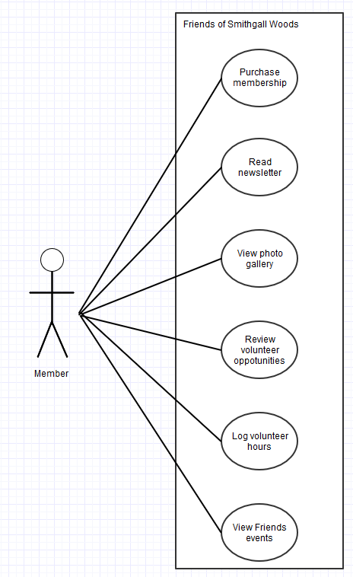
Friends Volunteer Use Cases

Slide 5
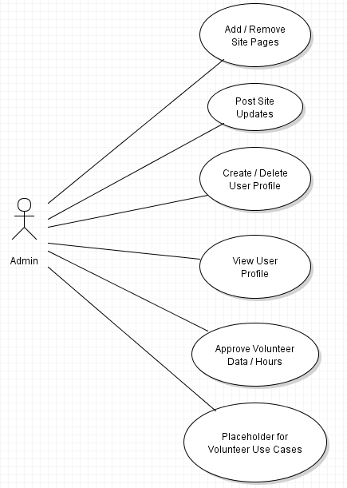
Admin Use Cases

Slide 6
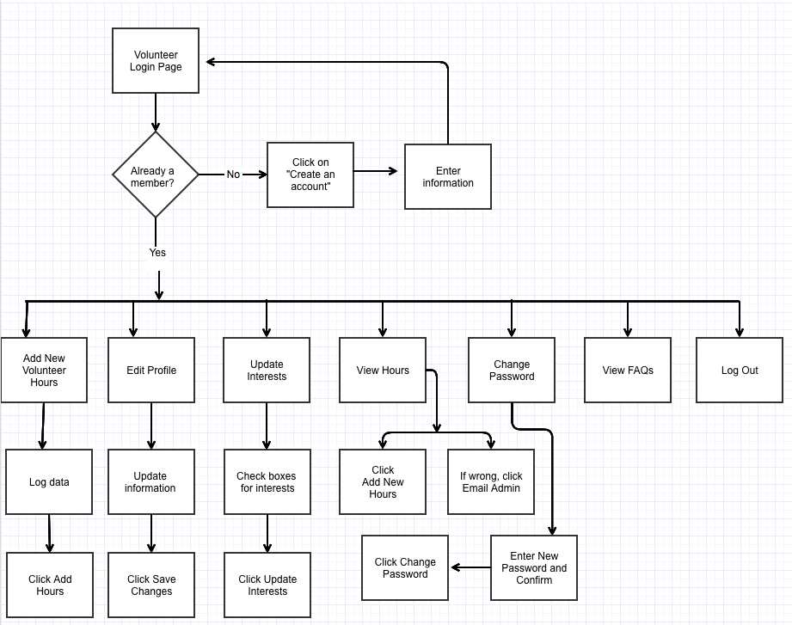
Friends Volunteer Workflow

Slide 7
Admin Workflow
Workflow will be provided later……

Slide 8
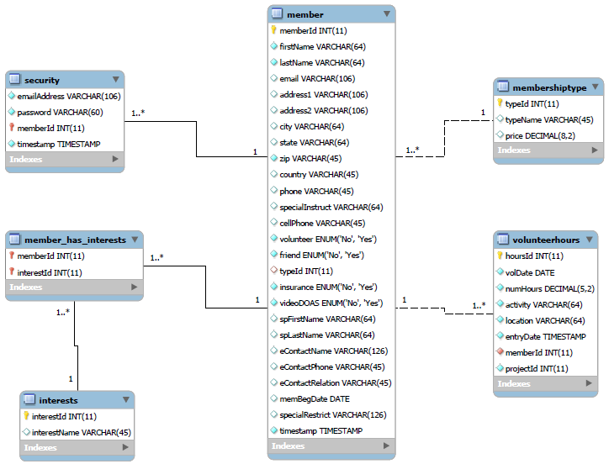
Existing Data Model

Slide 9
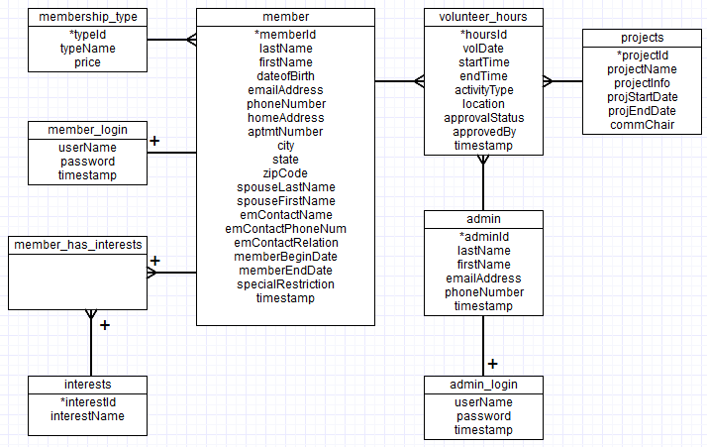
Suggested Data Model

Slide 10
Way Ahead
Continue working on Project Charter
Follow up with Mr. Pease to schedule initial project discussion
Continue building the website prototype
Refine logical models based on discussion with client

Slide 11
Questions

Slide 12
BACKUPS

Slide 13
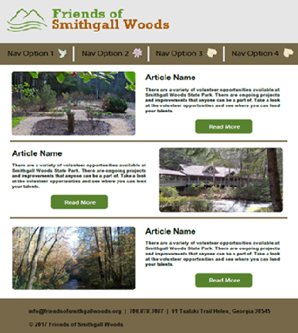
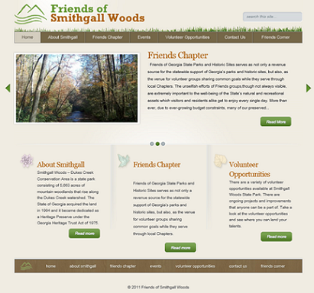
Home Page Mockup (Desktop Version)
Proposed Home Page
Current Home Page

Slide 14
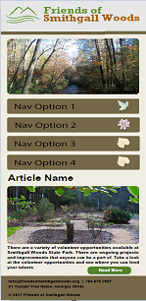
Home Page Mockup (Mobile Version)

